Slide 1
An Introduction to Recurrent Neural Networks
Sangeeta Oswal
VESIT

Slide 2
Outline
Recurrent Neural Networks
Vanilla RNN
Exploding and Vanishing Gradients
Networks with Memory
Long Short-Term Memory (LSTM)
Gated Recurrent Unit (GRU)
Sequence Learning Architectures
Sequence Learning with one RNN Layer
Sequence Learning with multiple RNN Layers
Notes:
I’m going to avoid all the math and focus on the intuition behind RNNs instead.

Slide 3


Sequence Learning
apple
bus
10
5
car
10
5
.
.
In feedforward and convolutional neural networks the size of the input was always fixed
For example, we fed fixed size (32 × 32) images to convolutional neural networks for image classification
Similarly in word2vec, we fed a fixed window (k) of words to the network
Further, each input to the network was independent of the previous or future inputs
For example, the computatations, outputs and decisions for two success- ive images are completely independ- ent of each other
3/41

Slide 4
Sequence Learning
e
e
p
( stop ⟩
In many applications the input is not of a fixed size
Further successive inputs may not be independent of each other
For example, consider the task of auto completion
Given the first character ‘d’ you want to predict the next character ‘e’ and so on
d
e
e
p
4/41

Slide 5
Sequence Learning
e
e
p
( stop ⟩
First, successive inputs are no longer independent (while predicting ‘e’ you would want to know what the previous input was in addition to the cur- rent input)
Second, the length of the inputs and the number of predictions you need to make is not fixed (for example, “learn”, “deep”, “machine” have different number of characters)
Third, each network (orange-blue- green structure) is performing the same task (input : character output: character)
d
e
e
p
4/41

Slide 6
Consider the task of predicting the part of speech tag (noun, adverb, adjective verb) of each word in a sentence
noun
verb
article adjective noun
Once we see an adjective (social) we are almost sure that the next word should be a noun (man)
Thus the current output (noun) depends on the current input as well as the previous input
Further the size of the input is not fixed (sentences could have arbitrary number of words)
man
is
a
social animal
7/41

Slide 7
don’t care
don’t care
don’t care
don’t care
don’t
care +/−
Instead we would look at the full se-
quence and then produce an output
For example, consider the task of pre- dicting the polarity of a movie review
The prediction clearly does not de- pend only on the last word but also on some words which appear before
Here again we could think that the network is performing the same task at each step (input : word, output :
The
movie
was
boring
and
long
+/−) but it’s just that we don’t care
about intermediate outputs
8/41

Slide 8
Sequence Learning : RNN
y₁
y₂
What is the function being executed at each time step ?
s_{i} = σ(Ux_{i} + b) y_{i} = O(V s_{i} + c) i = timestep
V
V
s₁ s₂
U
U
Since we want the same function to be executed at each timestep we should share the same network (i.e., same parameters at each timestep)
x₁
x₂
13/41
CS7015 (Deep Learning) : Lecture 14

Slide 9
RNN
y₁
y₂
y₃
y₄
yn
This parameter sharing also ensures that the network becomes agnostic to the length (size) of the input.
V
V
V
V
V
Since we are simply going to compute the same function (with same para- meters) at each timestep, the number of timesteps doesn’t matter.
We just create multiple copies of the network and execute them at each timestamp.
s₁ s₂ s₃ s₄ . . .
s_{n}
U
U
U
U
U
x₁
x₂
x₃
x₄
xn
14/41

Slide 10
^{y}1
^{y}2
v
v
How do we account for dependence between inputs ?
u
u
Let us first see an infeasible way of doing this
At each timestep we will feed all the previous inputs to the network
Is this okay ?
No, it violates the function
^{x}1
^{x}1
^{x}2
^{y}3
^{y}4
v
v
u
u
y₁ = f₁(x₁)
y₂ = f₂(x₁, x₂)
y₃ = f₃(x₁, x₂, x₃)
^{x}1
^{x}2
^{x}3
^{x}1
^{x}2
^{x}3
^{x}4
15/41
CS7015 (Deep Learning) : Lecture 14

Slide 11
RNN
y₁
y₂
y₃
y₄
yn
s_{i} = σ(Ux_{i} + Ws_{i−1} + b) y_{i} = O(V s_{i} + c)
or
y_{i} = f (x_{i}, s_{i−1}, W, U, V, b, c)
V
V
V
V
V
W
W
W
^{W} . . . ^{W}
s_{n}
s is the state of the network at
i
timestep i
U
U
U
U
U
The parameters are W, U, V, c, b
which are shared across timesteps
The same network (and parameters) can be used to compute y₁, y₂, . . . , y₁₀ or y₁₀₀
x₁
x₂
x₃
x₄
xn
add a recurrent connection in the network
17/41
CS7015 (Deep Learning) : Lecture 14

Slide 12
Recurrent Neural Networks
Human brain deals with information streams. Most data is obtained, processed, and generated sequentially.
E.g., listening: soundwaves 🡪 vocabularies/sentences
E.g., action: brain signals/instructions 🡪 sequential muscle movements
Human thoughts have persistence; humans don’t start their thinking from scratch every second.
As you read this sentence, you understand each word based on your prior knowledge.
The applications of standard Artificial Neural Networks (and also Convolutional Networks) are limited due to:
They only accepted a fixed-size vector as input (e.g., an image) and produce a fixed-size vector as output (e.g., probabilities of different classes).
These models use a fixed amount of computational steps (e.g. the number of layers in the model).
Recurrent Neural Networks (RNNs) are a family of neural networks introduced to learn sequential data.
Inspired by the temporal-dependent and persistent human thoughts
Notes:
Human brain processes data in sequential manner. For example, lets understand what do you mean by sequential data. Click on link.
Sequence data comes in many forms. Audio is a natural sequence. You can chop up an audio spectrogram into chunks and feed that into RNN’s.
Text is another form of sequences. You can break Text up into a sequence of characters or a sequence of words. E.g live to eat and eat to live have different meaning for us but models will treat them equally.
RNN’s are good at processing sequence data for predictions. But how??
Well, they do that by having a concept of memory.
I want to invite you to say the alphabet in your head.
ABCDEFGHIJKLMNOPQRSTUVWXYZ
Pretty easy right..
Now lets try saying the alphabet backwards.
ZYXWVUTSRQPONMLKJIHGFEDCBA
I am sure this was much harder.. Unless you are seldon copper..
Ok lets try the sequence from letter k,
At first you’ll struggle with the first few letters, but then after your brain picks up the pattern, the rest will come naturally. So there is a very logical reason why this can be difficult. You learn the alphabet as a sequence. Sequential memory is a mechanism that makes it easier for your brain to recognize sequence patterns.
So we will pin this thought of sequential patterns and revisit it in coming slides.
Not all problems can be converted into one with fixed-length inputs and outputs
Problems such as Speech Recognition or Time-series Prediction require a system to store and use context information
Simple case: Output YES if the number of 1s is even, else NO 1000010101 – YES, 100011 – NO, …
Hard/Impossible to choose a fixed context window
There can always be a new sample longer than anything seen
Lets look at how does an RNN replicate this concept of sequential pattern and memory?

Slide 13
Real-life Sequence Learning Applications
RNNs can be applied to various type of sequential data to learn the temporal patterns.
Time-series data (e.g., stock price) 🡪 Prediction, regression
Raw sensor data (e.g., signal, voice, handwriting) 🡪 Labels or text sequences
Text 🡪 Label (e.g., sentiment) or text sequence (e.g., translation, summary, answer)
Image and video 🡪 Text description (e.g., captions, scene interpretation)
Task | Input | Output
Activity Recognition (Zhu et al. 2018) | Sensor Signals | Activity Labels
Machine translation (Sutskever et al. 2014) | English text | French text
Question answering (Bordes et al. 2014) | Question | Answer
Speech recognition (Graves et al. 2013) | Voice | Text
Handwriting prediction (Graves 2013) | Handwriting | Text
Opinion mining (Irsoy et al. 2014) | Text | Opinion expression

Slide 14
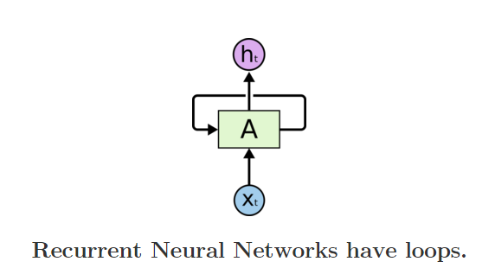
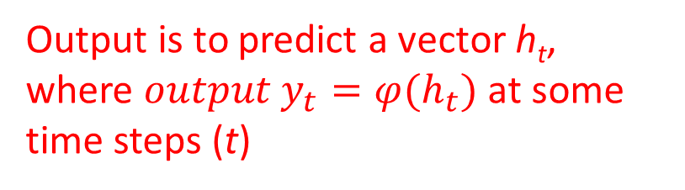
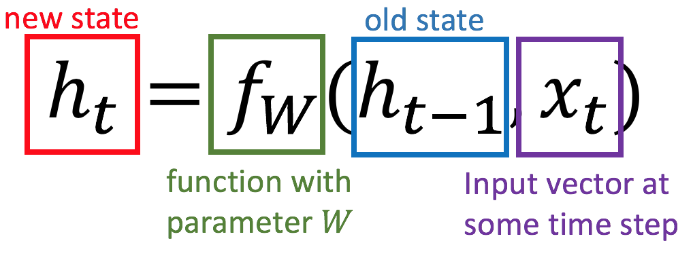
Recurrent Neural Networks
Recurrent Neural Networks are networks with loops, allowing information to persist.

Slide 15
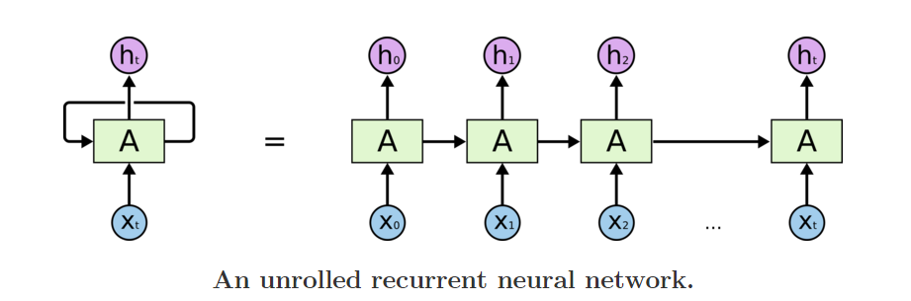
Recurrent Neural Networks
Unrolling RNN
A recurrent neural network can be thought of as multiple copies of the same network, each passing a message to a successor. The diagram above shows what happens if we unroll the loop.

Slide 16
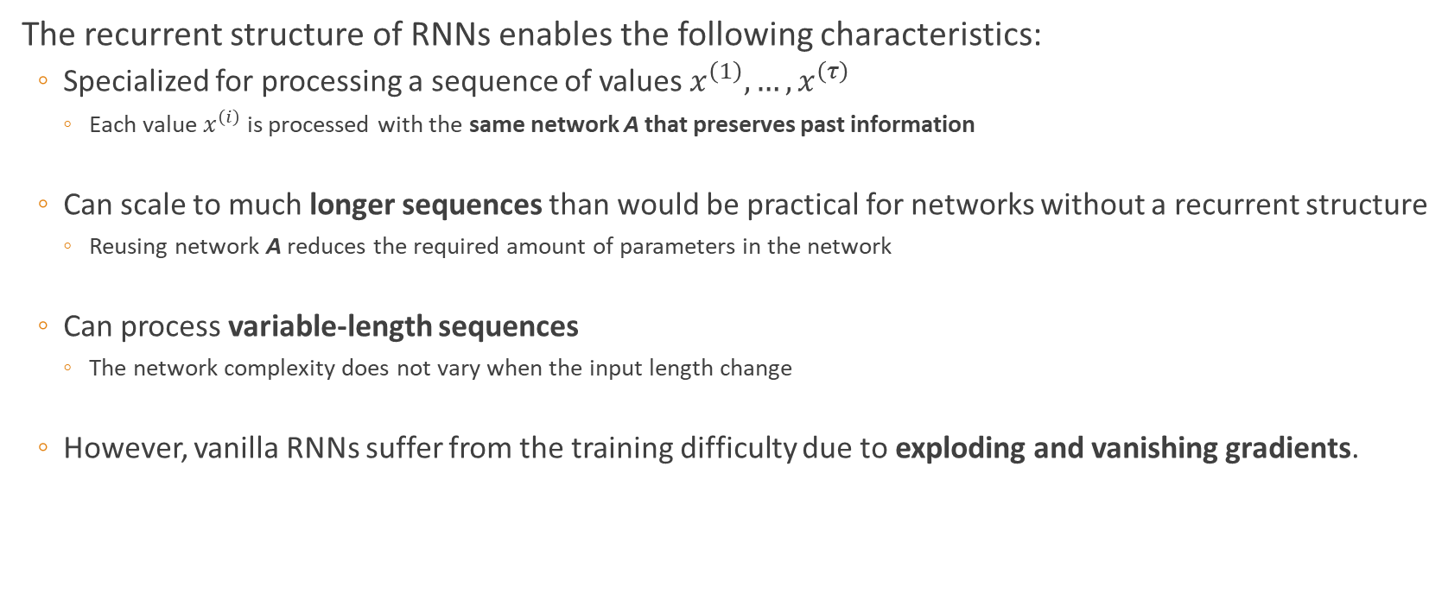
Recurrent Neural Networks

Slide 17
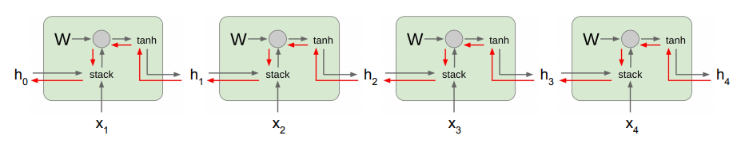
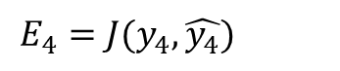
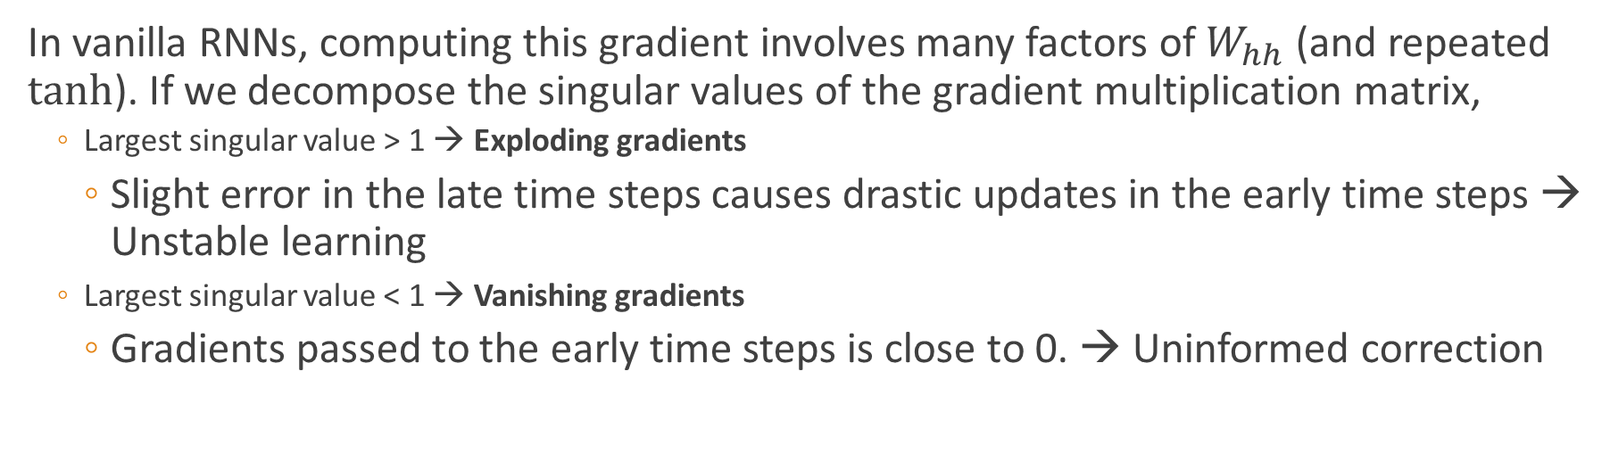
Exploding and Vanishing Gradients

Slide 18
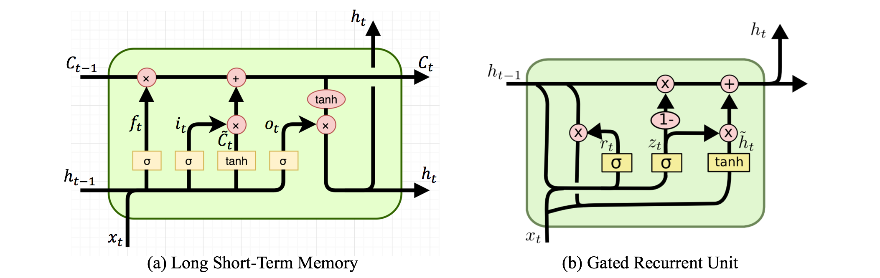
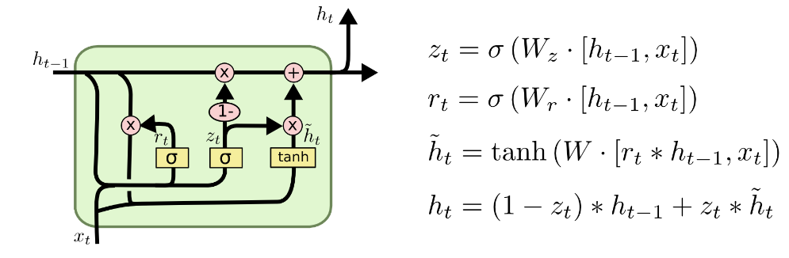
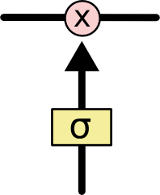
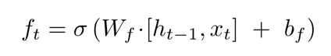

Networks with Memory
Vanilla RNN operates in a “multiplicative” way (repeated tanh).
Two recurrent cell designs were proposed and widely adopted:
Long Short-Term Memory (LSTM) (Hochreiter and Schmidhuber, 1997)
Gated Recurrent Unit (GRU) (Cho et al. 2014)
Both designs process information in an “additive” way with gates to control information flow.
Sigmoid gate outputs numbers between 0 and 1, describing how much of each component should be let through.
Standard LSTM Cell
GRU Cell
E.g.
= Sigmoid ( W_{f} x_{t} + U_{t} h_{t-1} + b_{f} )
A Sigmoid Gate

Slide 19

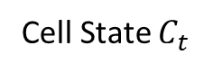

Long Short-Term Memory (LSTM)
The key to LSTMs is the cell state.
Stores information of the past 🡪 long-term memory
Passes along time steps with minor linear interactions 🡪 “additive”
Results in an uninterrupted gradient flow 🡪 errors in the past pertain and impact learning in the future
The LSTM cell manipulates input information with three gates.
Input gate 🡪 controls the intake of new information
Forget gate 🡪 determines what part of the cell state to be updated
Output gate 🡪 determines what part of the cell state to output
Gradient Flow
Notes:
https://colah.github.io/posts/2015-08-Understanding-LSTMs/

Slide 20
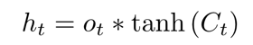
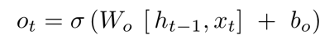
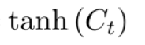
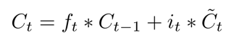
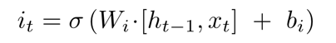
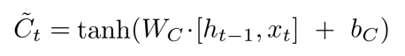
LSTM: Components & Flow
LSM unit output
Output gate units
Transformed memory cell contents
Gated update to memory cell units
Forget gate units
Input gate units
Potential input to memory cell

Slide 21

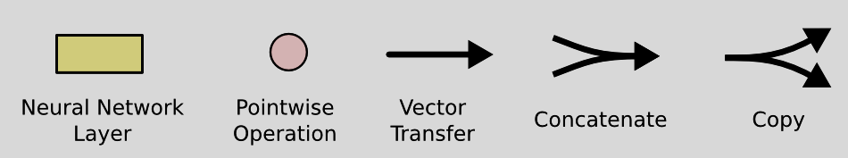
The long-short term memory (LSTM) module
LSTMs are explicitly designed to avoid the long-term dependency problem.

Slide 22
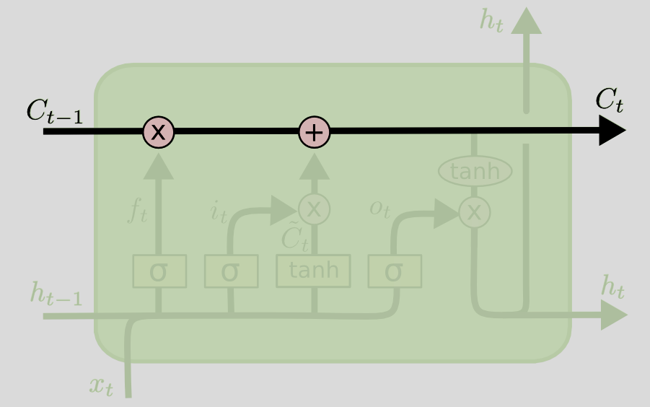
Two keys of LSTM
“Cell state” which works like a conveyor belt runs straight down the entire chain, easy for information to flow along without changes.
“Gates” which control or decide what kind of information could go or throw away from the cell state.
Gate
Cell state
Notes:
The key to LSTMs is the cell state, the horizontal line running through the top of the diagram.
The cell state is kind of like a conveyor belt. It runs straight down the entire chain, with only some minor linear interactions. It’s very easy for information to just flow along it unchanged.
The LSTM does have the ability to remove or add information to the cell state, carefully regulated by structures called gates.
Gates are a way to optionally let information through. They are composed out of a sigmoid neural net layer and a pointwise multiplication operation.

Slide 23
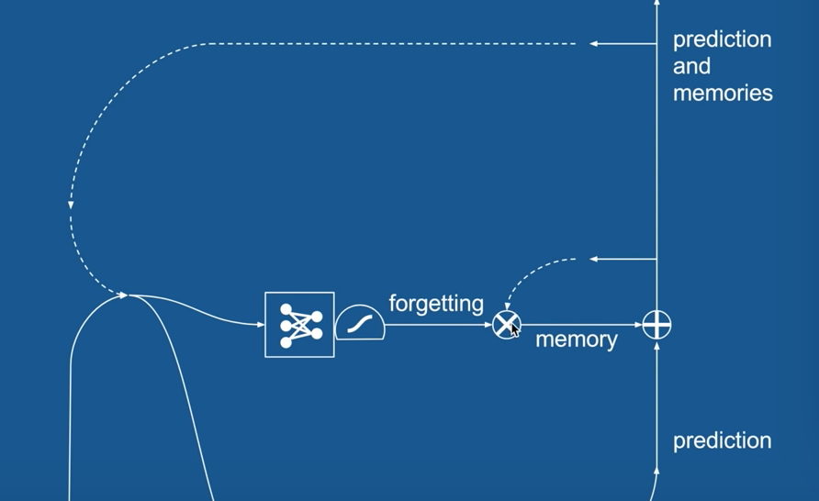

LSTM – forget gate
Take the example of a language model trying to predict the next word based on all the previous ones. In such a problem, the cell state might include the gender of the present subject, so that the correct pronouns can be used. When we see a new subject, we want to forget the gender of the old subject.
Notes:
The first step in our LSTM is to decide what information we’re going to throw away from the cell state. This decision is made by a sigmoid layer called the “forget gate layer.”

Slide 24
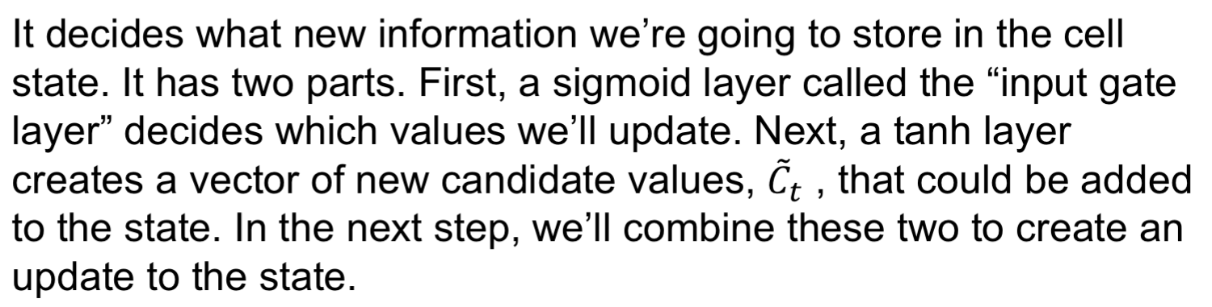

LSTM – input gate
Notes:
The next step is to decide what new information we’re going to store in the cell state. This has two parts. First, a sigmoid layer called the “input gate layer” decides which values we’ll update. Next, a tanh layer creates a vector of new candidate values, C~tC~t, that could be added to the state. In the next step, we’ll combine these two to create an update to the state.

Slide 25

LSTM – cell state update
It actually drops the information about the old subject’s gender and add the new information, as we decided in the previous steps.
Notes:
It’s now time to update the old cell state, Ct−1Ct−1, into the new cell state CtCt. The previous steps already decided what to do, we just need to actually do it.

Slide 26

LSTM – output gate
Notes:
Finally, we need to decide what we’re going to output. This output will be based on our cell state, but will be a filtered version. First, we run a sigmoid layer which decides what parts of the cell state we’re going to output. Then, we put the cell state through tanhtanh (to push the values to be between −1−1 and 11) and multiply it by the output of the sigmoid gate, so that we only output the parts we decided to.

Slide 27
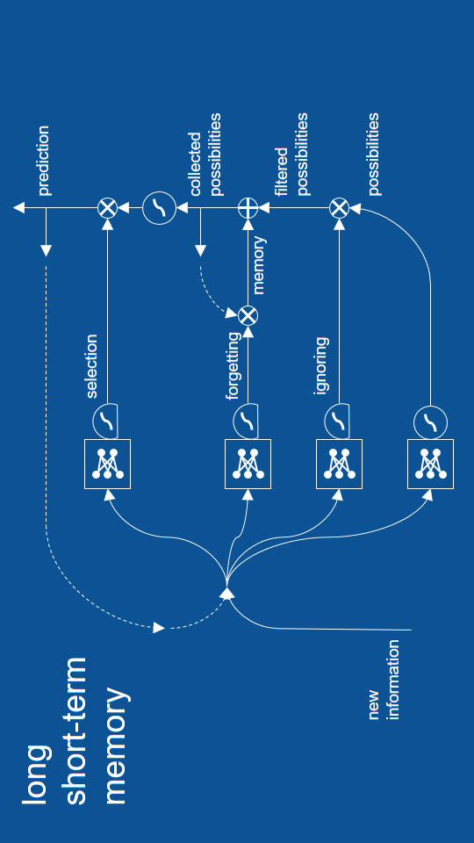
LSTM - revisit

Slide 28
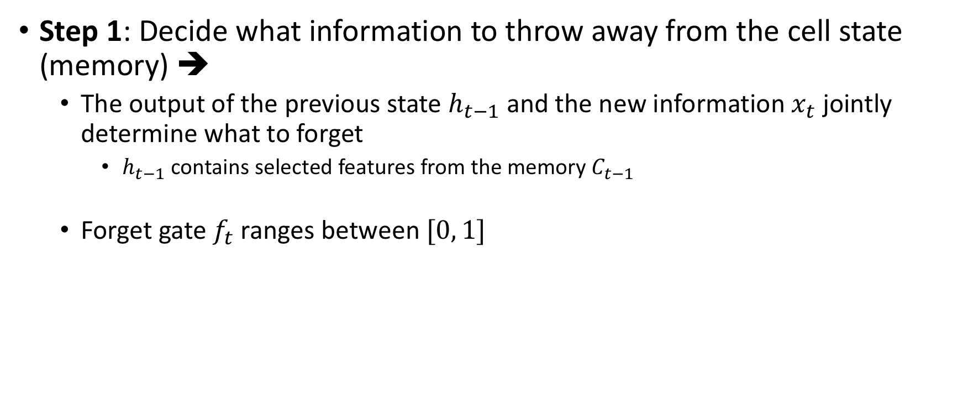
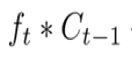
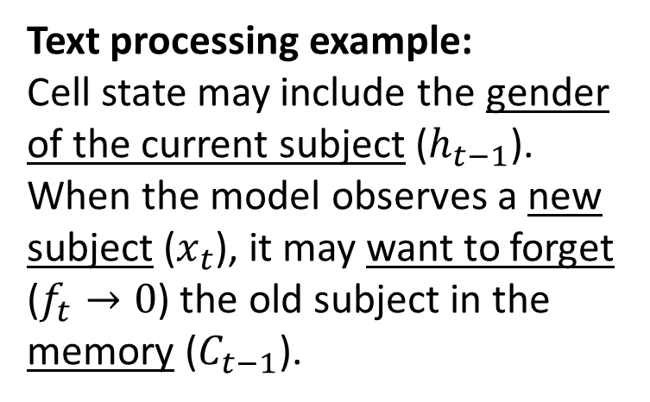
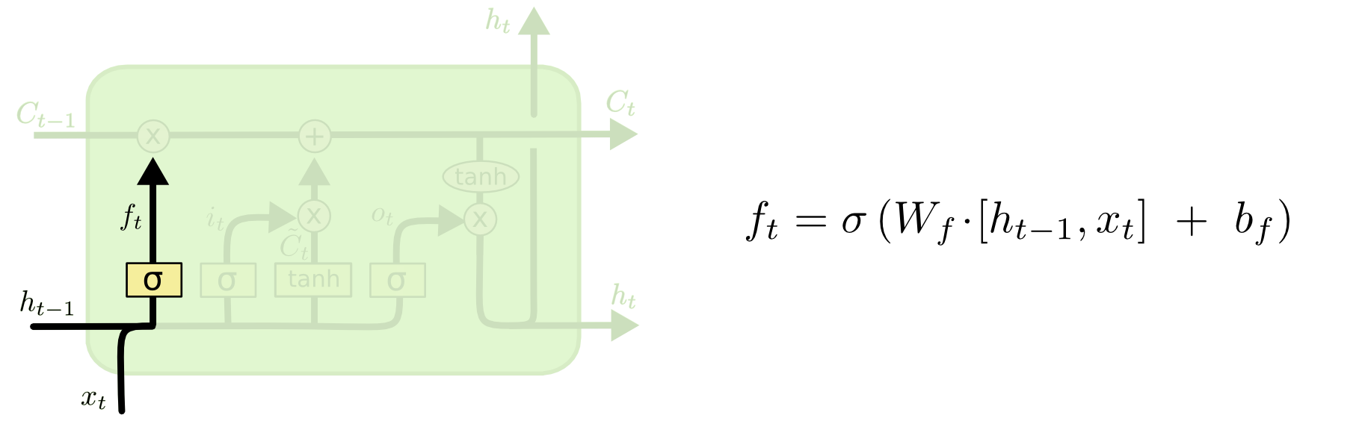
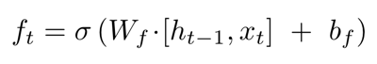
Step-by-step LSTM Walk Through
Forget gate

Slide 29
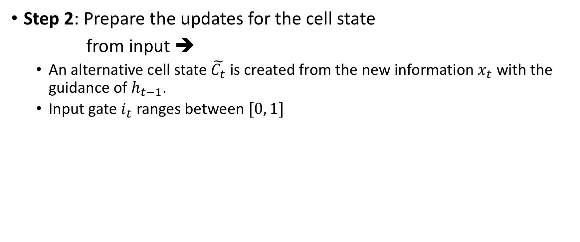
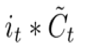
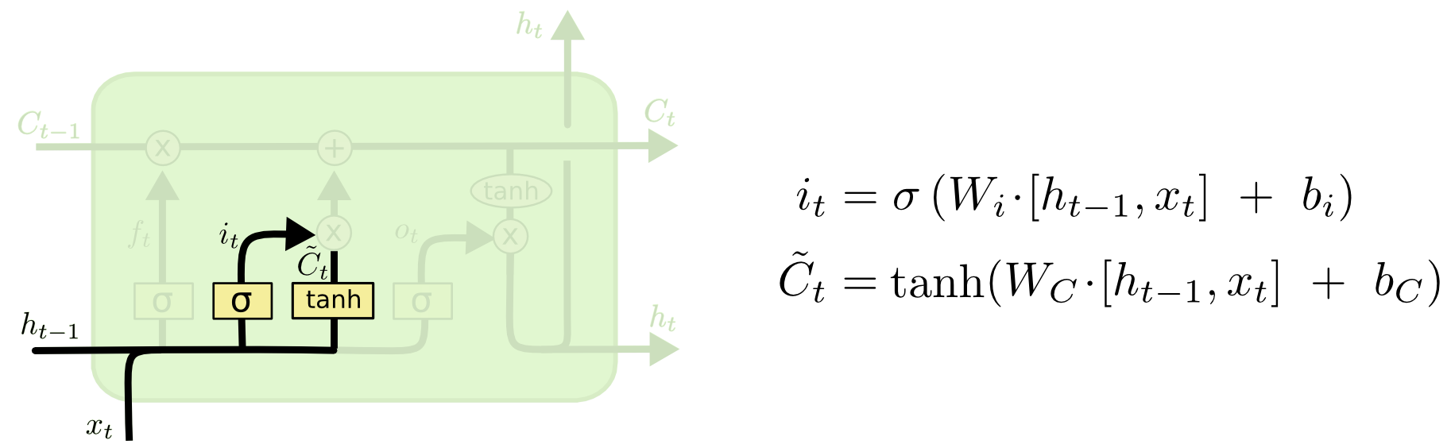
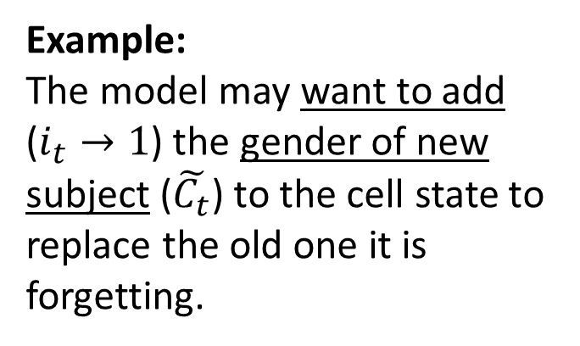
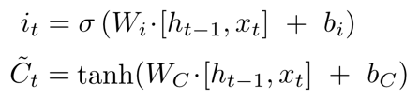
Step-by-step LSTM Walk Through
Input gate
Alternative cell state

Slide 30
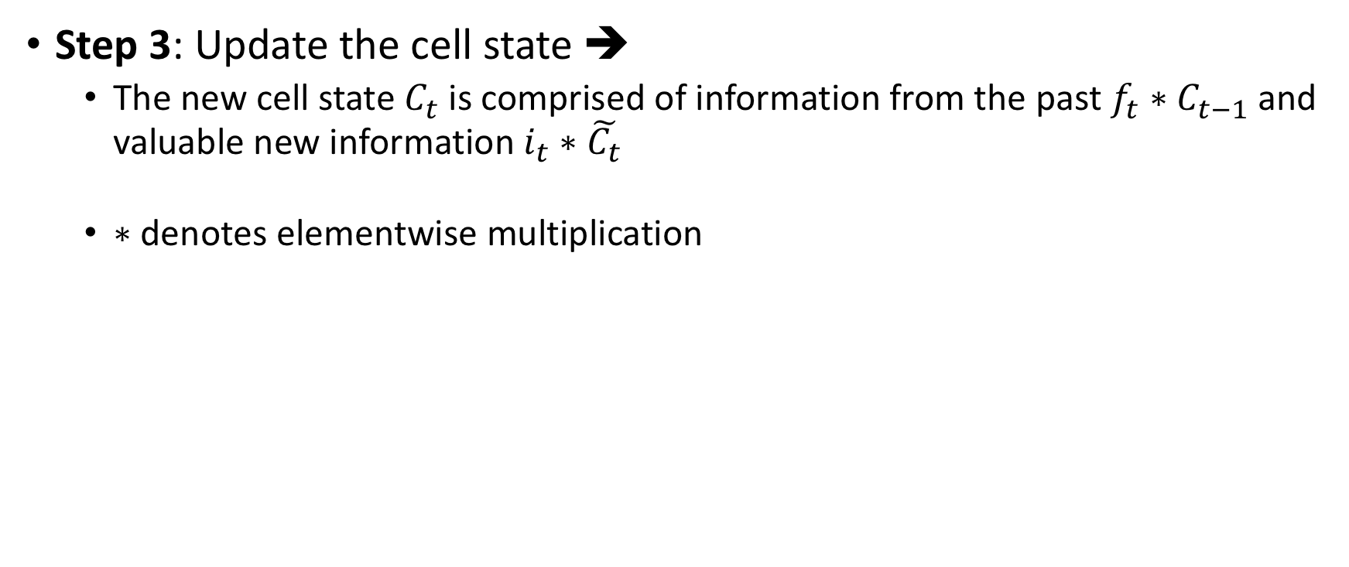
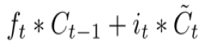
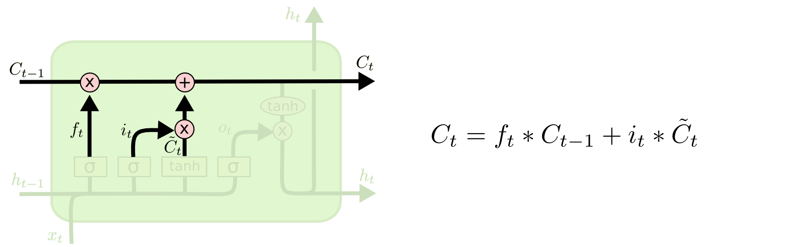
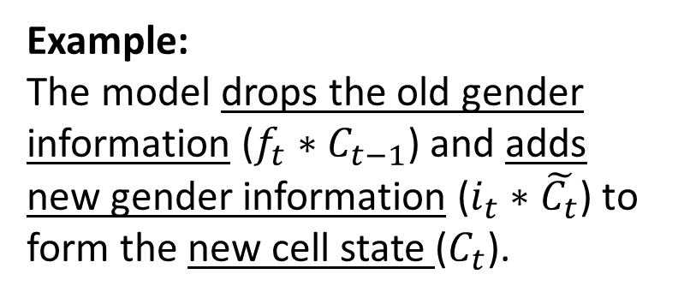
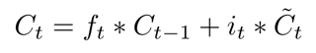
Step-by-step LSTM Walk Through
New cell state

Slide 31
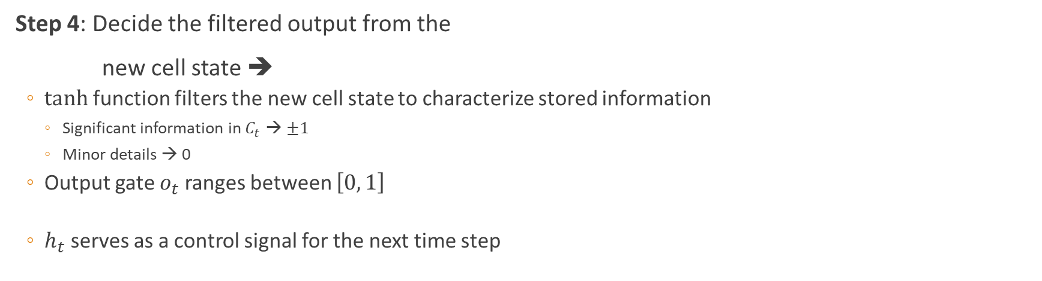
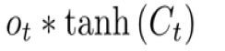
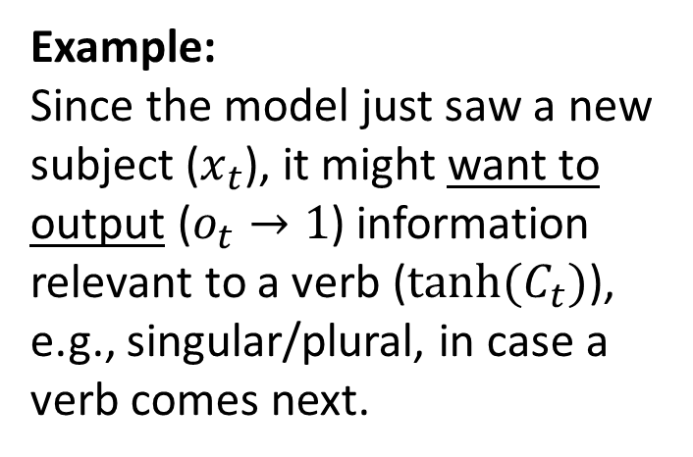
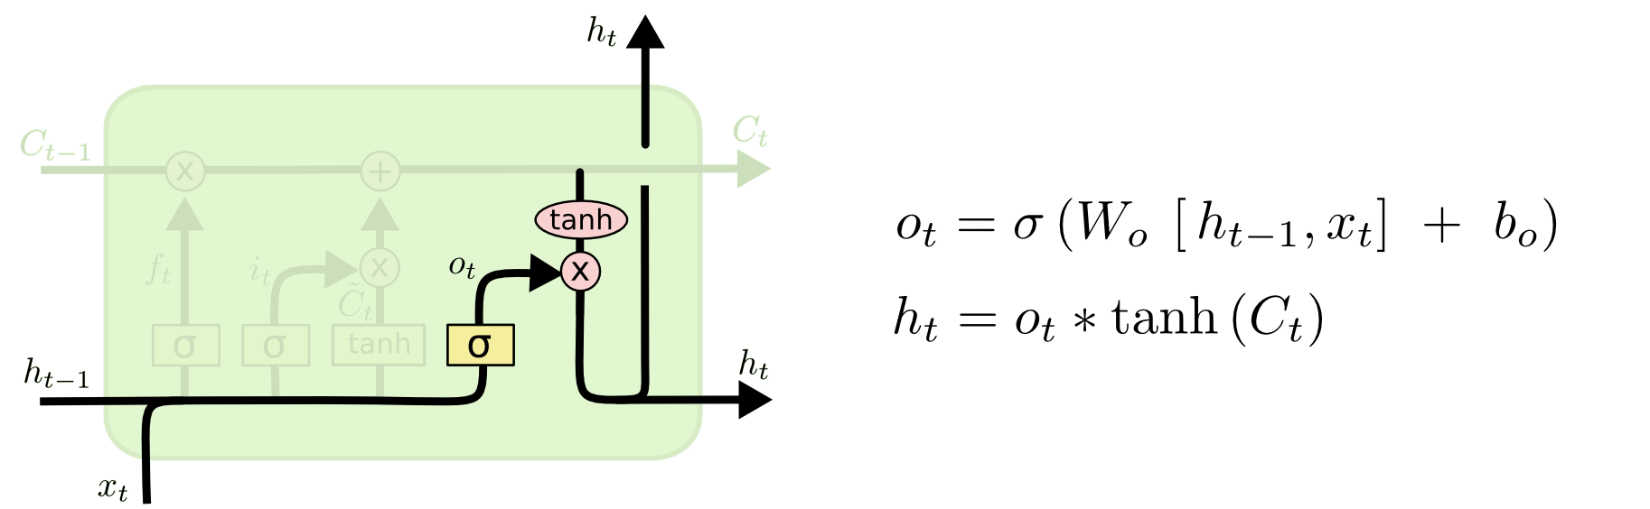
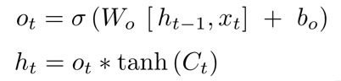
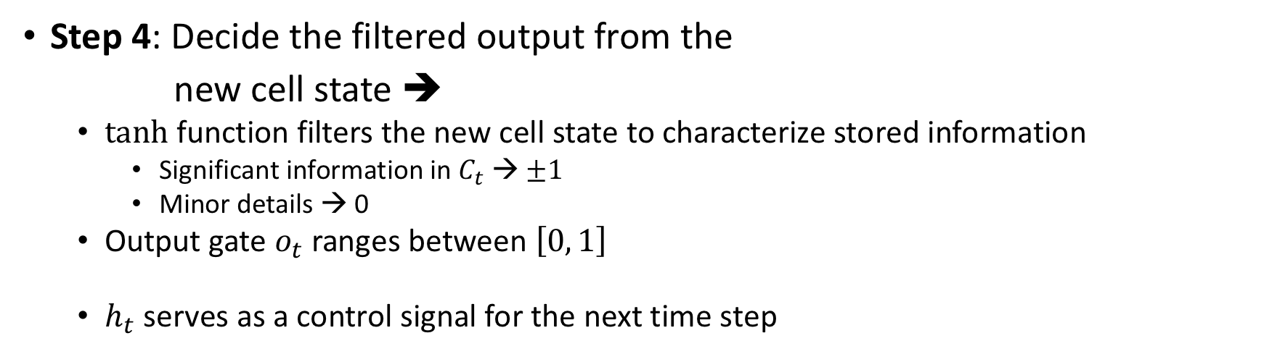
Step-by-step LSTM Walk Through
Output gate

Slide 32
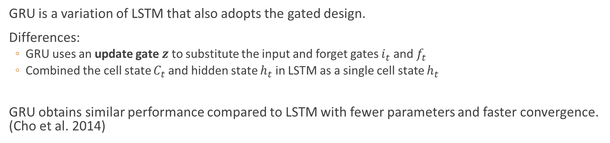

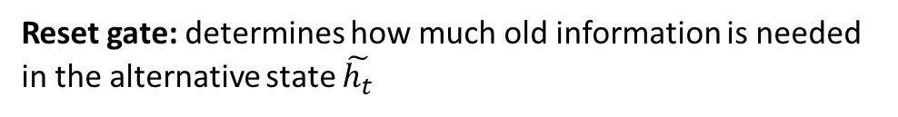
Gated Recurrent Unit (GRU)
Update gate: controls the composition of the new state
Alternative state: contains new information
New state: replace selected old information with new information in the new state

Slide 33
The gated recurrent units (GRUs) module
Similar with LSTM but with only two gates and less parameters.
The “update gate” determines how much of previous memory to be kept.
The “reset gate” determines how to combine the new input with the previous memory.

Slide 34
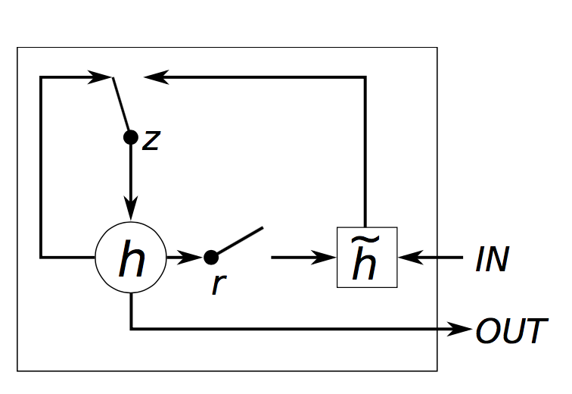
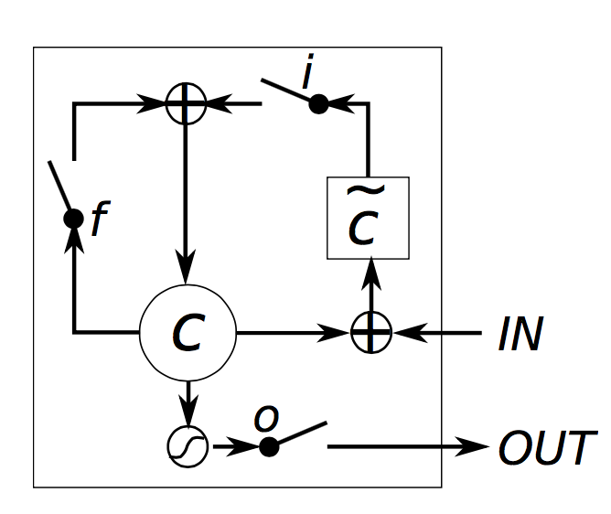
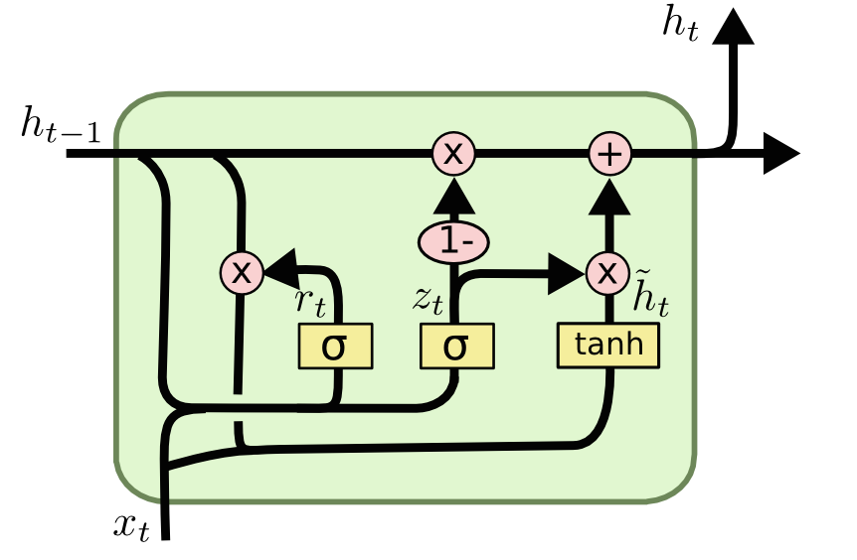
Comparison of the gating mechanism

Slide 35

GRU

Slide 36
LSTM vs. GRU

Slide 37
Sequence Learning Architectures
Learning on RNN is more robust when the vanishing/exploding gradient problem is resolved.
RNNs can now be applied to different Sequence Learning tasks.
Recurrent NN architecture is flexible to operate over various sequences of vectors.
Sequence in the input, the output, or in the most general case both
Architecture with one or more RNN layers

Slide 38

Sequence Learning with One RNN Layer
1
2
3
4
5
Notes:
Each rectangle is a vector and arrows represent functions (e.g. matrix multiply).
Input vectors are in red, output vectors are in blue and green vectors hold the RNN's state
(1) Standard NN mode without recurrent structure (e.g. image classification, one label for one image).
This type of neural network is known as the Vanilla Neural Network. It's used for general machine learning problems, which has a single input and a single output.
(2) Sequence output (e.g. image captioning, takes an image and outputs a sentence of words).
(3) Sequence input (e.g. sentiment analysis, a sentence is classified as expressing positive or negative sentiment).
(4) Sequence input and sequence output (e.g. machine translation, a sentence in English is translated into a sentence in French).
(5) Synced sequence input and output (e.g. video classification, label each frame of the video).

Slide 39

Sequence Learning with Multiple RNN Layers
B
B
B
B

Slide 40
Sequence Learning with Multiple RNN Layers
Sequence-to-Sequence (Seq2Seq) model
Developed by Google in 2018 for use in machine translation.
Seq2seq turns one sequence into another sequence. It does so by use of a recurrent neural network (RNN) or more often LSTM or GRU to avoid the problem of vanishing gradient.
The primary components are one Encoder and one Decoder network. The encoder turns each item into a corresponding hidden vector containing the item and its context. The decoder reverses the process, turning the vector into an output item, using the previous output as the input context.
Encoder RNN: extract and compress the
semantics from the input sequence
Decoder RNN: generate a sequence based
on the input semantics
Apply to tasks such as machine
translation
Similar underlying semantics
E.g., “I love you.” to “Je t’aime.”
Decoded sequence
y₀
y₁
y₂
…
y_{m}
Encoded semantics
B
B
B
B
An RNN as the encoder
An RNN as the decoder
Input sequence

Slide 41








Few Studies and Publications

Slide 42
Summary
LSTM and GRU are RNNs that retain past information and update with a gated design.
The “additive” structure avoids vanishing gradient problem.
RNNs allow flexible architecture designs to adapt to different sequence learning requirements.
RNNs have broad real-life applications.
Text processing, machine translation, signal extraction/recognition, image captioning
Mobile health analytics, activity of daily living, senior care

Slide 43
Thank you
QUESTION??

Slide 44
Sequential data
Back
Notes:
Say you take a still snapshot of a ball moving in time.
Let’s also say you want to predict the direction that the ball was moving. So with only the information that you see on the screen, how would you do this? Well, you can go ahead and take a guess, but any answer you’d come up with would be that, a random guess. Without knowledge of where the ball has been, you wouldn’t have enough data to predict where it’s going.
If you record many snapshots of the ball’s position in succession, you will have enough information to make a better prediction.
So this is a sequence, a particular order in which one thing follows another. With this information, you can now see that the ball is moving to the right.

